Slide 1
18CSE390T
Computer Vision
S9-Pose Estimation

Slide 2
Pose Estimation
Estimating an object’s 3D pose from a set of 2D point projection
Pose estimation problem is also known as extrinsic calibration
Problem of recovering pose from three correspondences, which is the minimal amount of information necessary,
is known as the perspective-3-point-problem (P3P),
Extensions to larger numbers of points collectively known as PnP

Slide 3
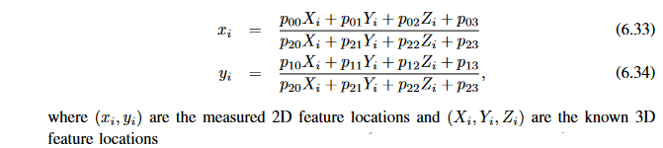
Direct linear transform (DLT)
Simplest way to recover the pose of the camera is to form a set of linear equations analogous to those used for 2D motion estimation from the camera matrix form of perspective projection

Slide 4
System of equations can be solved in a linear fashion for the unknowns in the camera matrix P by multiplying the denominator on both sides of the equation.
The resulting algorithm is called the direct linear transform
To compute the 12 (or 11) unknowns in P , at least six correspondences between 3D and 2D locations must be known.

Slide 5
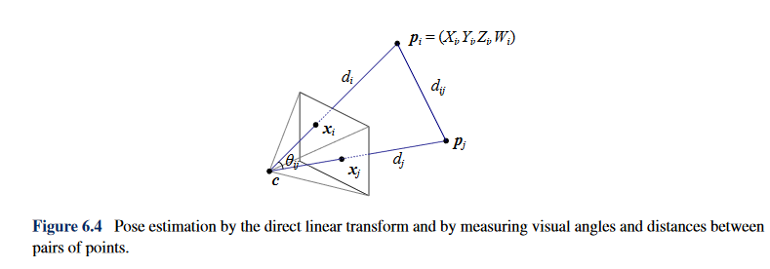

Slide 6
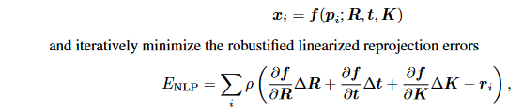
Iterative Algorithm
Most accurate (and flexible) way to estimate pose is to directly minimize the squared (robust) reprojection error for the 2D points as a function of the unknown pose parameters in
(R, t) and optionally K using non-linear least

Slide 7
Iterative Algorithm
ri = ̃xi − ˆxi is the current residual vector (2D error in predicted position) and the partial derivatives are with respect to the unknown pose parameters (rotation, translation, and
optionally calibration)
If full 2D covariance estimates are available for the 2D
feature locations, the above squared norm can be weighted by the inverse point covariance
matrix,

